Slide 1

Accessing Form Elements-Part 2

Slide 2
Covered Till Now
Find the "Email Address" Text field using the id locator.
Find the "Password" field using the name locator
Enter text into the "Email Address" using the sendKeys() method.
Enter a password into the "Password" field using the sendKeys() method.
Delete the values

Slide 3
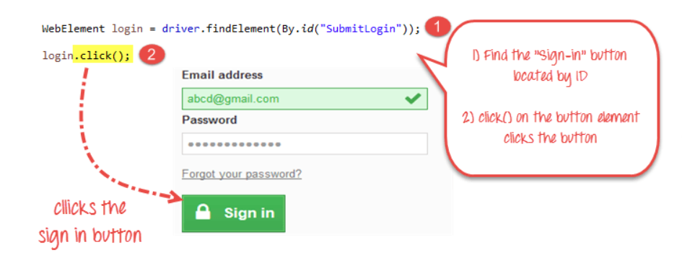
Buttons
The buttons can be accessed using the click() method.
Click on the "Sign-in" Button in the login page of the site to login to the site.

Slide 4
Submit Buttons
Submit buttons are used to submit the entire form to the server.
We can either use the click () method on the web element like a normal button as we have done above
Or use the submit () method on any web element in the form or on the submit button itself.
When submit() is used, WebDriver will look up the DOM to know which form the element belongs to, and then trigger its submit function.

Slide 5
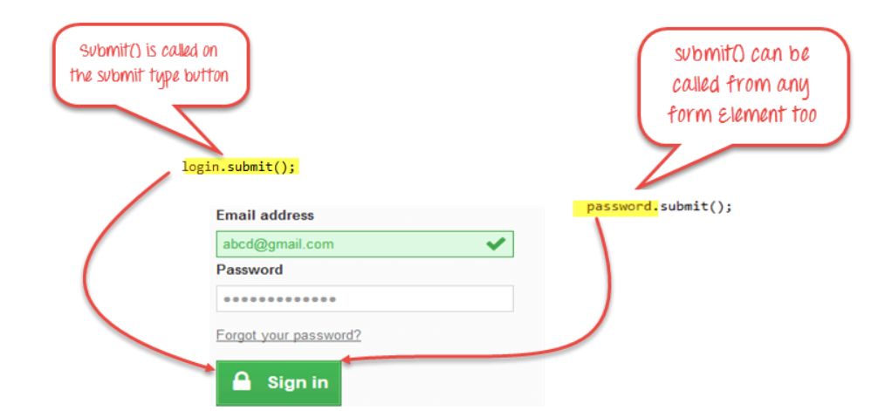

Slide 6
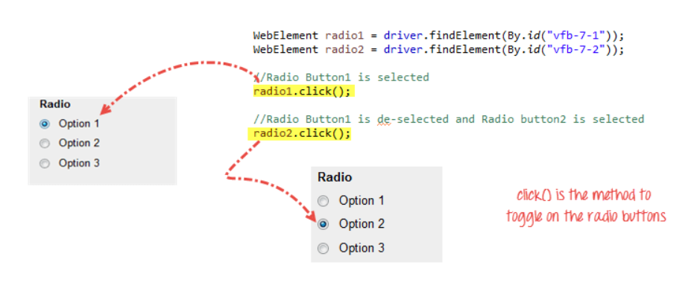
Radio Buttons
Radio Buttons too can be toggled on by using the click() method.

Slide 7
Check Box
Toggling a check box on/off is also done using the click() method.
The code below will click on Facebook's "Keep me logged in" check box twice and then output the result as TRUE when it is toggled on, and FALSE if it is toggled off.

Slide 8
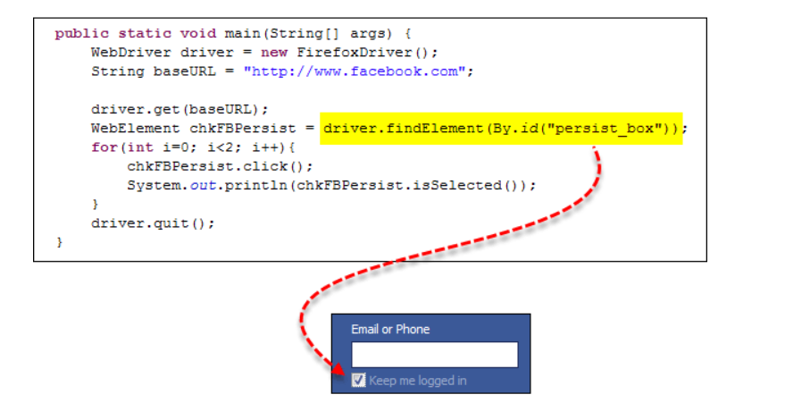

Slide 9
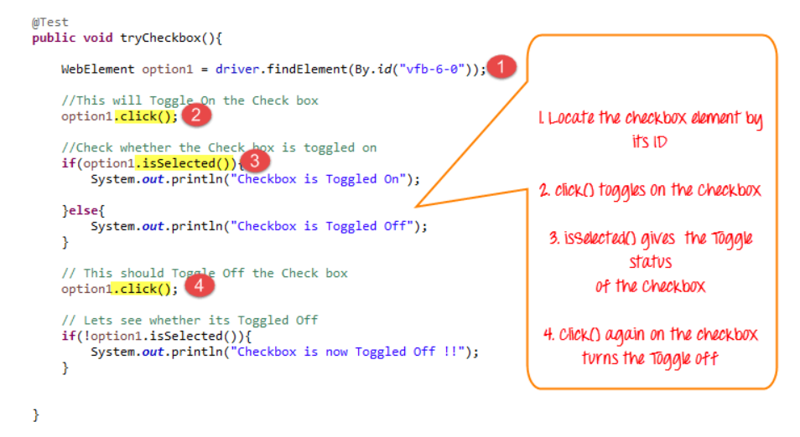
isSelected() method
isSelected() method is used to know whether the Checkbox is toggled on or off.

Slide 10
NoSuchElementException()
It means that the element is not found in the page at the point the Web driver accessed the page.
It can be due to multiple reasons:
Check your locator again using Firepath or Inspect Element in Chrome.
Check whether the value you used in the code is different from the one for the element in Firepath now.
Some properties are dynamic for few elements. In case, you find that the value is different and is changing dynamically, consider using By.xpath() or By.cssSelector() which are more reliable but complex ways.
Sometimes, it could be a wait issue too i.e., the Web driver executed your code even before the page loaded completely, etc.
Add a wait before findElement() using implicit or explicit waits.

Slide 11
Summary
Element | Command | Description
Input Box | sendKeys() | used to enter values onto text boxes
 | clear() | used to clear text boxes of its current value
Check Box, Radio Button, | click() | used to toggle the element on/off
Links | click() | used to click on the link and wait for page load to complete before proceeding to the next command.
Submit Button | submit()

Slide 12
Thanks

